Slide 1
01. fundamentals of cloud computing

Slide 2
1.1] define cloud computing : -
Cloud Computing is the on-demand availbility of computer system resources, especially data storage (cloud storage) and computing power, without direct active management by the user.
The term is generally used to describe data centers available to many users over the Internet.
Clouds may be limited to a single organization (enterprise cloud) or be available to multiple organizations (public cloud).
These computing services include servers, storage, databases, networking, software, analytics & intelligence are moved outside an organization's firewall & can be accessed via the web.
Cloud computing offers platform independency, as the software is not required to be installed locally on the PC.

Slide 3
Essential characteristics of cloud computing : -
There are basically five essential characteristics of cloud computing : -
1. ON-Demand Self Service : - Cloud customers can quickly sign up, pay for, and start using cloud resources on their own without help from a sales agent.
2. Broad Network Access : - Customers access cloud services via the internet.
3. Resource Pooling : - Different types of customers (individuals, organizations, or different departments within an organization) all use the same servers, storage, or other computing resources.
4. Rapid elasticity or expansion : - Cloud customers can easily scale their use of resources up or down as their needs change.
5. Measured service : - Customers pay for the amount of resources they use in a given period of time rather than paying for hardware or software upfront.

Slide 4
1.2] cloud deployment model : -
Cloud Deployment Model is defined according to where the infrastructure for the deployment resides and who has control over that infrastructure.
Deciding which deployment model you will go with is one of the most important cloud deployment decisions you will make.
Each cloud deployment model satisfies different organizational needs, so it's important that you choose a model that will satisfy the needs of your organization.
Perhaps even more important is the fact that each cloud deployment model has a different value proposition & different costs associated with it.

Slide 5
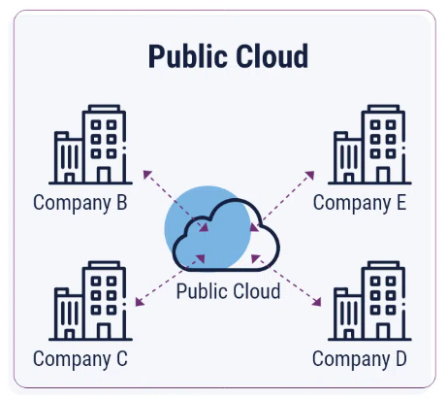
Public cloud : -
The public cloud makes it possible for anybody to access system & services. It may be less secure as it is open to everyone.
In public cloud, computing resources are managed & operated by the cloud service provider (CSP).
Most common uses of public clouds are for application development and testing, non-mission-critical tasks such as file-sharing, and e-mail service.
A public cloud can offer any kind of service: infrastructure, platform or applications. For Example : -
(a) Amazon EC2.
(b) Google App Engine.
(c) Salesforce.com

Slide 6
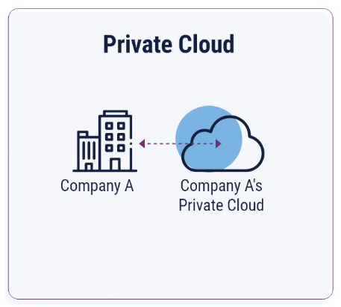
Private cloud : -
Private cloud is known as internal cloud or corporate cloud, is typically infrastructure used by a single organization.
It is used by organizations to build and manage their own data centers internally or by the third party.
Private Clouds are more expensive than public clouds due to the capital expenditure involve in acquiring & maintaining them.
However, private clouds are better to able to address the security and privacy concerns of organizations.
Private clouds can be deployed using Opensource tools such as openstack and eucalyptus.
Examples: VMware vSphere, openstack, Microsoft Azure Stack, oracle Cloud at customer, & IBM Cloud Private.

Slide 7
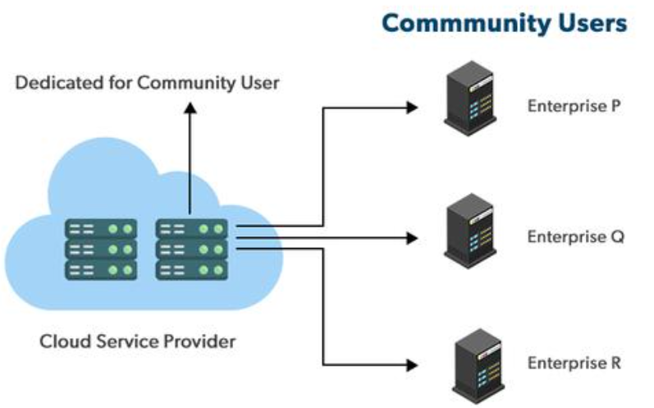
Communiity cloud : -
This deployment model supports multiple organizations sharing computing resources that are part of a community.
Examples include universities cooperating in certain areas of research, or police departments within a country or state sharing computing resources.
It is generally managed by a third party or by the combination of one or more organizations in the community.
Access to a community cloud environment is typically restricted to the members of the community.
Ex. Health care Community.

Slide 8
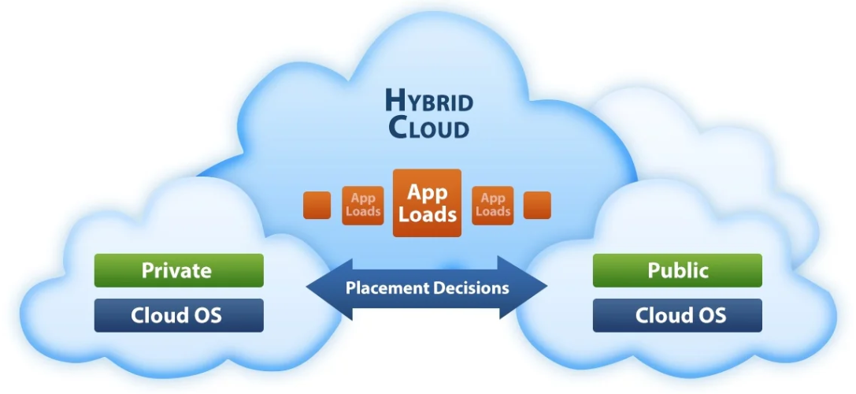
Hybrid cloud : -
In a Hybrid cloud, the organization makes use of inter-connected private and public cloud infrastructure.
With a hybrid solution, you may host the app in a safe environment while taking advantage of the public cloud's cost savings.
Many organizations make use of this model when they need to scale up their IT infrastructure rapidly.
Examples : - Google Application suite (Gmail, Google Apps, and Google Drive), Amazon Web Services.

Slide 9
1.3] cloud service models : -
The cloud service model refers to the structure and methodology by which cloud computing services are provided.
It defines the division of responsibilities between cloud service provider and the customer.
Cloud Service Models : -
1. Infrastructure-as-a-Service [IaaS].
2. Platform-as-a-Service [PaaS].
3. Software-as-a-Service [SaaS].

Slide 10
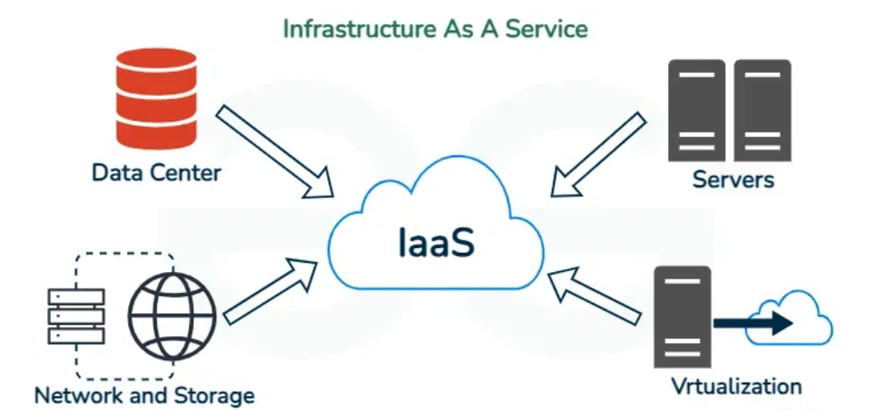
1. Iaas (infrastructure-as-a-service) : -
Iaas is also known as Hardware-as-a- Service (Haas). It allows the cloud provider to Freely locate the infrastructure over the Internet in a cost-effective manner.
Iaas allows the customer to access computing resources through administrative access to virtual machines.
Iaas provides access to fundamental resources such as physical machines, virtual machines, virtual storage, bandwidth, IP address, monitoring services, Firewalls, ete to the customer on rent.
The payment is based upon the amount of time the customer retains a resource also with administrative access to virtual machines, the customer can run any software, even an operating system.
Iaas is generally used by Network Architects.
Examples : - Amazon Web Services (AWS), Rackspace, Cisco Metopod, Microsoft Azure, Google Compute Engine (GCE).

Slide 11
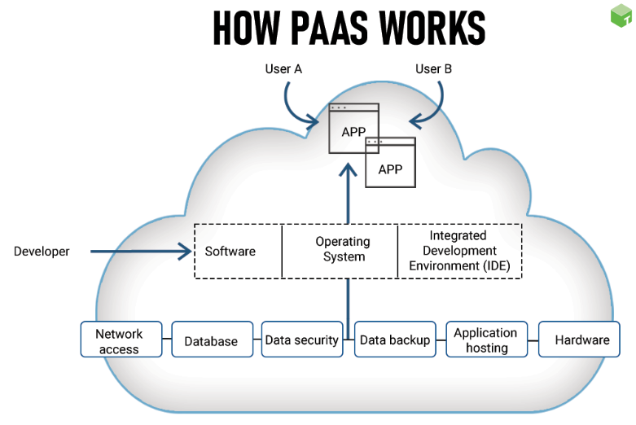
Paas (platform-as-a-service) : -
PaaS provides customers a complete platform for the programmer to develop, test, run and manage the applications.
PaaS has a feature of point-and-click tools that enables non-developers to create web applications.
In this customers need not bother about the administration because it is the responsibility of the cloud service Provider.
Customer need not purchase expensive hardware, servers, power and data storage.
PaaS is generally used by developers.
Examples : - Windows Azure, Heroku, Force.com, Google App Engine, Apache Statos, Openshift.

Slide 12
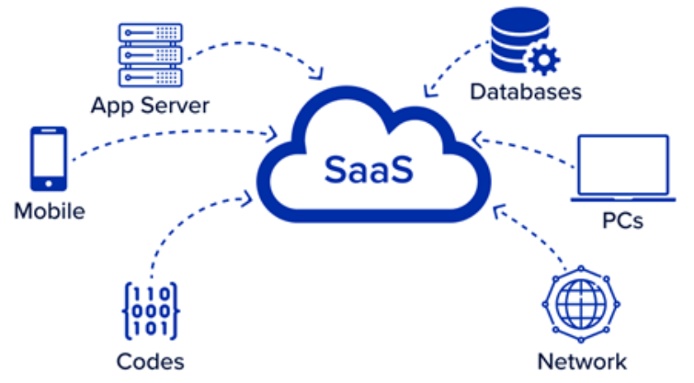
saas (Software-as-a-service) : -
Saas is also known as " on-demand software" which provide software applications as a service to end-users. Users can access these applications with the help of internet connection and web browser.
In this model, an Independent Software Vendor (ISU) may contract a third-party cloud provider to host the application.
The Saas application deployment requires a little or no client-side software installation.
Thus, there is no requirement for complex software packages on the client-side.
Customers can customize their application without affecting the core Functionality.
Saas provides us with an Application Programming Interface (API), which allows the developer to develop a customized application.
Saas is generally used by the end-user.
Examples : - Google Workspace, Salesforce, Concur, Gmail, Microsoft office.

Slide 13
1.4] cloud economics & benefits : -
Cloud Economics in cloud computing refers to the study & analysis of the Financial implications of using cloud services.
It involves understanding and managing the costs, benefits and Financial trade-offs associated with cloud adoption.
Following are the key aspects of Cloud Economics -
1. Cost Models : -
2. Cost Management and optimization : -
3. Total cost of ownership : -
4. Return of Investment : -

Slide 14
1. Cost models : -
a) Pay-as-you-go : - Users pay only for the resources they consume, such as computing power, storage and data transfer. This model helps in avoiding large upfront capital expenditures.
b) Subscription-Based : - fixed fees for predefined levels of service, offering predictability in costs.
c) Reserved Instances : - Discounts offered for committing to use specific cloud services over a longer period.

Slide 15
2. Cost management & optimization : -
a) Resource Allocation - Efficiently managing and allocating resources to minimize waste and reduce cost.
b) Auto Scaling - Automatically adjusting resources based on demand, preventing over-provisioning & reducing expenses.
c) Monitoring & Reporting - Tools and services that provide insights into resource usage and costs, helping in budget management.

Slide 16
3. Total Cost of ownership (TCO) : - a) Direct Costs : - Expenses for cloud services, including computing, storage and data transfer. b) Indirect Costs : - Costs related to training, migration, compliance and security.
4. Return of Investment (ROI) : -
a) Value Assessment - Evaluating the financial benifits and savings from using cloud services, compared to traditional IT infrastructure.

Slide 17
Benefits : -
1) Scalability : - Easily scalable resources up or down based on demand. If the business demand increases you can easily increase your cloud capacity without having to invest in physical infrastructure.
2) Improved Collaboration : - The cloud computing platform helps employees who are located in different geographies to collaborate in a highly convenient & secure manner.
3) Data Security : - Cloud storage provides us implementation protection for their platforms and the data they process such as authentication, access control & encryption.
4) Back-up and restore data : - Once the data is stored in a cloud, it is easier to get the back-up & recovery of that, which is otherwise very time taking process on premise.
5) Flexibility : - Access resources and applications from any-where with an internet connection.
6) Pay-per-use-Model : - Cloud computing uses Pay-per-us Model that enables companies to pay for the services they really utilize. This method is affordable, eliminates the need for up-front investments and offers budget management Flexibility for IT.

Slide 18
1.5] architecture of cloud computing : -
- Cloud computing Architecture is a combination of service- oriented architecture and Event-driven architecture.
* FRONT END : -
i) Front End is used by the Client.
ii) It contains client-side interfaces and applications that
are required to access the cloud computing platforms.
iii) The front end includes web servers (including Chrome, Firefox, internet explorer, etc), thin & fat client, tablets, and mobile devices.
* BACK END : -
i) The back end is used by the service provider.
ii) It manages all the resources that are required to provide cloud computing services.
iii) It includes a huge amount of data storage, security mechanism, virtual machines, deploying models, servers, traffic control mechanisms, etc.

Slide 19
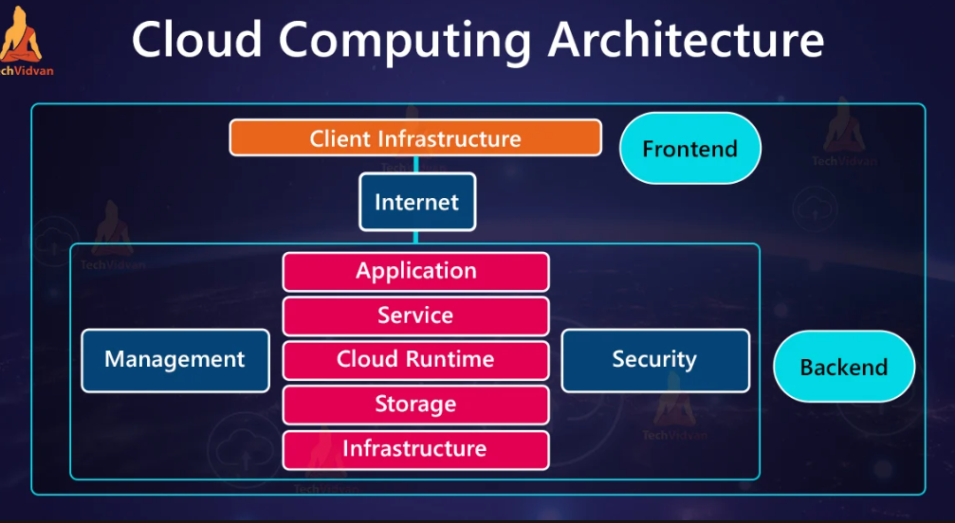

Slide 20
1. Client Infrastructure : - Client Infrastructure is a front end component. It provides GUI to interact with the cloud.
2. Application : - The application may be any software or platform that a client wants to access.
3. Service : - A Cloud Services manages that which type of service you access according to the client's requirement.
4. Runtime Cloud : - Runtime Cloud provides the execution & runtime environment to the virtual machines.
5. Storage : - Storage is one of the most important components cloud computing. It provides a huge amount of storage capacity in the cloud to store and manage data.
6. Infrastructure : - It provides services on the host level, application level and network level. cloud infrastructure includes hardware & software components such as servers, storage, network devices, virtualization software, and other storage resources that are needed to support the cloud computing model.
7. Management : - It manages components such as application, service, runtime cloud, storage, infrastructure, and other security issues in the backend and establish coordination between them.
8. Security : - Security is an in-built back end component of cloud computing. It implements a security mechanism in the back-end.
9. Internet : - It is a medium through which frontend and backend can interact of communicate with each other.

Slide 21
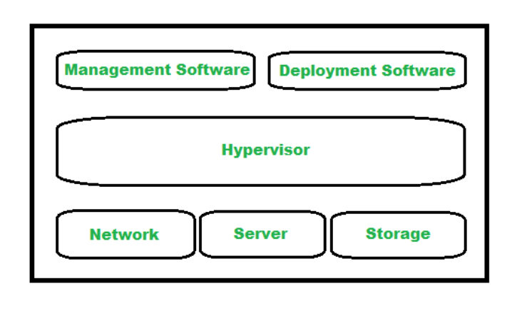
1.6] cloud computing infrastructure : -
Cloud infrastructure which comes under the backend part of cloud architecture represents the hardware & software components such as server, storage, networking, management software, deployment software & virtualization software.
It is a collection of hardware and software elements needed to enable cloud computing.
Cloud infrastructure has more capabilities of providing the same services as the physical infrastructure to the customers.
It is available for private cloud, public cloud and hybald cloud systems with low cost, greater flexibility and scalability.

Slide 22
1. Hypervisor : - i) Hypervisor is a firmware or a low level program which is a key to enable virtualization. ii) It is used to divide and allocate cloud resources between several customers. iii) As it monitors and manages cloud services, Hypervisor is called as VMM (Virtual Machine Monitor) or (Virtual Machine Manager).
2. Management Software : -
i) Management software helps in maintaining and configuring the infrastructure.
ii) It monitors and optimizes resources, data, applications and services.

Slide 23
3. Deployment Software : - i) Deployment software helps in deploying and integrating the application on the cloud. ii) So, typically it helps in building a virtual computing environment.
4. Network : -
i) It is one of the key components of cloud infrastructure which is responsible for connecting cloud services over the internet.
ii) It is also possible to deliver network as a utility over the Internet, which means, the customer can customize the network route and protocol.

Slide 24
5. Server : - i) server is responsible for managing and delivering cloud services for various services and partners, maintaining security, etc. ii) The server helps to compute the resource sharing and offers other services such as resource allocation & de-allocation, etc.
6. Storage : -
i) storage provides storing and managing data.
ii) Cloud Keeps multiple replicas of storage. If one of the
storage resources fails, then it can be extracted from
another one, which makes cloud computing more reliable.

